Slide 1

STANLEY COLLEGE OF ENGINEERING AND TECHNOLGY FOR WOMEN (AUTONOMOUS)
Abids. Hyderabad – 500 001
(Affiliated to Osmania University & Approved by AICTE)
(All eligible UGC courses are accredited by NBA & NAAC with ‘A’ Grade)
Department of Computer Science and Engineering
Academic Year: 2025-2026
B.E Major Project Phase-I
“Design & Development of a Data-Driven Market and Forecast Web Application”
Guide Name: Mr. M. Sai Ramakrishna
Designation: Assistant Professor
Department of CSE
PRESENTED BY
Name : Sana Kaleem
Roll no : 160622733115

Slide 2
INTERNSHIP - II DETAILS
Course Code: SPW611 CS Credits: 1 Evaluation: CIE - 50 Marks
Title: INTERNSHIP Presentation on “Design & Development of a Data-Driven Market and Forecast Web Application”
Name of the student: Sana Kaleem
Roll Number: 160622733115
Batch / Section: 2024 – 2025 / B
Name of the Organization: Unified Mentor
Duration of Internship: From 15th June 2025 to 15th July 2025
Mode (Onsite / Online / Hybrid): Online
Industry Supervisor: S. Kalpande
Faculty Coordinator / Supervisor: Mr . M. Sai RamaKrishna

Slide 3
Contents
Problem Statement
Background / Literature Review
Planning & Design of work
Implementation & Execution
Testing / Validation
Result & Analysis
Challenges & Solutions
Conclusion & Future Scope

Slide 4
Problem Statements
Businesses struggle to understand market trends and predict future demand.
Small companies lack proper tools for data collection and analysis.
This causes issues in sales planning, stock management, and decision-making.
The “Market and Forecast” project aims to build a simple web-based solution.
The platform helps users analyze market data and make predictions easily.
Developed using HTML for a user-friendly interface.
Allows users to view, analyze, and forecast market trends visually.
Objectives:
Design and develop a market analysis and forecasting web app.
Provide an easy interface to access real-time market data.
Enable prediction of future trends using market information.
Simplify data visualization with interactive charts and graphs.
Use modern web technologies for accuracy and efficiency.

Slide 5
Background & Literature Review
In today’s digital world, data helps businesses make better decisions and plan for the future. The market keeps changing with customer needs and competition, making it hard to predict future demand. Many existing tools are complex, costly, and not suitable for small businesses. Web-based applications solve this problem as they are simple, easy to access, and need little technical setup.
Studies show that combining data analysis, forecasting, and visualization improves accuracy and helps users understand trends easily. Modern web technologies also make it possible to connect data storage, processing, and display in one platform. The “Market and Forecast” project uses these ideas to create a user-friendly web application that helps analyze market data, forecast trends, and support better business decisions.

Slide 6
Literature Review
Kumar et al. (2020) – Explained that data-driven systems help organizations make better business decisions by analyzing past trends and predicting future outcomes.
Patel and Singh (2021) – Found that web-based applications are easier to use and more cost-effective compared to traditional software tools.
Rao (2019) – Highlighted that small businesses struggle with complex forecasting systems, showing the need for simpler and more accessible platforms.
Sharma et al. (2022) – Suggested that combining data visualization with forecasting models improves user understanding and decision accuracy.
Ali and Verma (2021) – Discussed that integrating modern web technologies with predictive algorithms increases system efficiency and accuracy.
Mehta (2023) – Emphasized the importance of interactive dashboards and real-time data updates for better market analysis and forecasting.

Slide 7
Planning & Design of work
Planning and Design of Work
The work was divided into weekly tasks to ensure proper learning and timely completion.
Week 1 – Requirement Analysis & Technology Setup:
Understood project goals and web application objectives.
Identified key market data like sales figures, trends, and historical records.
Listed main features: dashboards, charts, forecast results, and reports.
Prepared the development environment for coding.
Week 2 – System Design & Database Planning:
Designed system architecture showing data flow between UI, server, and database.
Created Data Flow Diagrams (DFD) and Use Case Diagrams.
Planned the database structure for efficient data storage and access.
.

Slide 8
Week 3 – Module Development & Forecasting Implementation:
Developed backend modules for data processing and forecasting.
Implemented algorithms to predict market trends using historical data.
Integrated backend with the web interface for user interaction.
Conducted module-level testing to ensure correctness.
Week 4 – Testing, Visualization & Final Deployment:
Designed dashboards and charts for clear result visualization.
Performed testing for errors, performance, and usability.
Made final improvements for a smooth user experience.
Deployed the final web application and prepared documentation.

Slide 9
Implementation & Execution
The implementation phase was the main part of the internship, where all the planning and design were turned into a working web application. The work was done step by step using HTML, PHP, and SQL to make sure everything worked smoothly.
In the first stage, I focused on understanding what the system needed to do. I studied market data, past trends, and the main features required such as dashboards, charts, forecast results, and reports.
For the frontend, I used HTML to design the web pages. It helped in creating a clean, simple, and easy-to-use interface where users could view data.
The backend was developed using PHP, which handled all the main functions of the system. It processed user inputs, connected the web pages with the database, and displayed results like forecasts and reports.
The database was created using SQL to store and manage all the market data safely. It helped in saving, updating, and showing data whenever needed for analysis and forecasting.
During the Integration stage, I connected the frontend, backend, and database to make sure they worked together correctly. I checked all the features, fixed small issues, and made sure the system ran without errors.
In the final stage, the completed web application was tested on a local server. It was able to take real market data, generate forecasts, and display results properly.

Slide 10
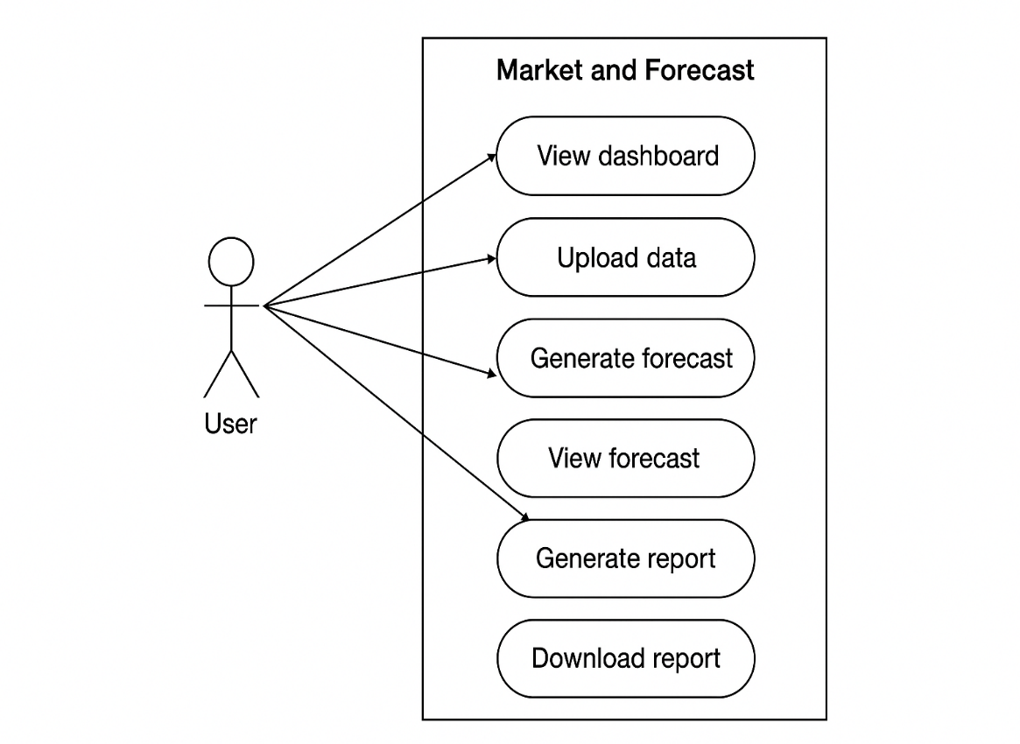
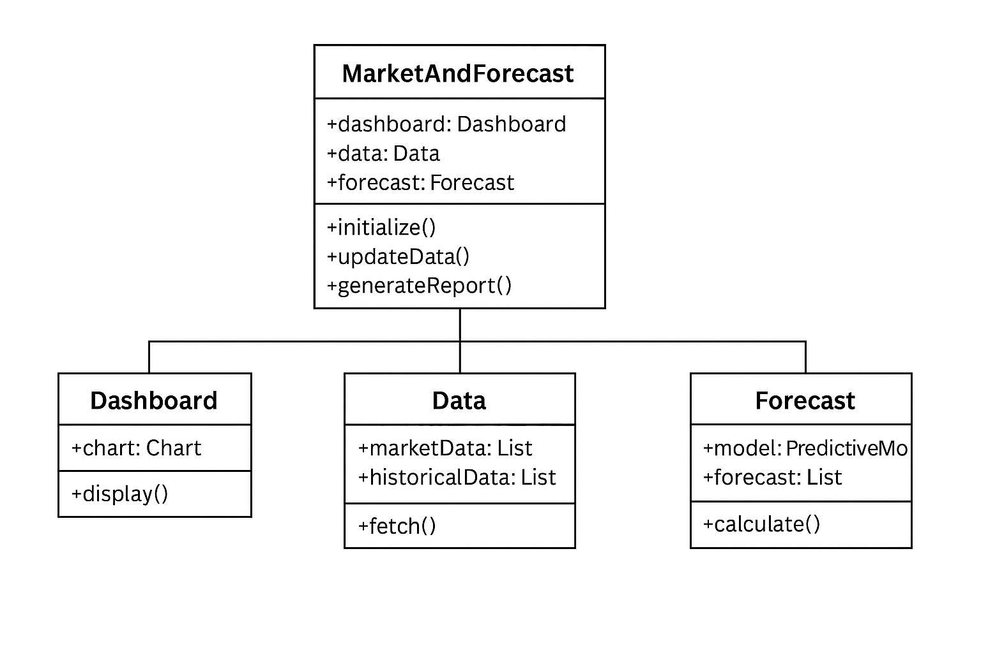
UML Diagram
Use Case Diagram
Class Diagram

Slide 11
Psuedo code
(SQL sets up the database and stores market data.)
//Implementation
-- Creating Database
CREATE DATABASE MarketForecastDB;
-- Use Database
USE MarketForecastDB;
-- Create Table for Market Data
CREATE TABLE MarketData (
ID INT PRIMARY KEY AUTO_INCREMENT,
ProductName VARCHAR(50),
Category VARCHAR(50),
Sales INT,
SaleDate DATE
-- Insert Sample Data
INSERT INTO MarketData (ProductName, Category, Sales, SaleDate)
VALUES
('Product A', 'Electronics', 120, '2025-01-01'),
('Product B', 'Electronics', 150, '2025-01-02'),
('Product C', 'Clothing', 90, '2025-01-01');

Slide 12
(HTML creates the dashboard for adding new data and viewing existing data)
<!DOCTYPE html>
<html>
<head>
<title>Market and Forecast Dashboard</title>
<style>
body { font-family: Arial, sans-serif; margin: 20px; }
table { border-collapse: collapse; width: 100%; margin-top: 20px; }
th, td { border: 1px solid #ccc; padding: 10px; text-align: left; }
th { background-color: #f2f2f2; }
.form-section { margin-bottom: 20px; }
</style>
</head>
<body>
<h1>Market and Forecast Dashboard</h1>
<!-- Data Entry Form -->
<div class="form-section">
<h3>Add New Market Data</h3>
<form action="add_data.php" method="post">
Product Name: <input type="text" name="ProductName" required><br><br>
Category: <input type="text" name="Category" required><br><br>
Sales: <input type="number" name="Sales" required><br><br>
Sale Date: <input type="date" name="SaleDate" required><br><br>
<input type="submit" value="Add Data">
</form>
</div>
<!-- Market Data Table -->
<div class="table-section">
<h3>Market Data</h3>
<table>
<tr>
<th>ID</th>
<th>Product Name</th>
<th>Category</th>
<th>Sales</th>
<th>Sale Date</th>
</tr>

Slide 13
<!-- PHP Code to Fetch Data from SQL Database -->
<?php
$conn = new mysqli("localhost", "root", "", "MarketForecastDB");
if ($conn->connect_error) { die("Connection failed: " . $conn->connect_error); }
$sql = "SELECT * FROM MarketData";
$result = $conn->query($sql);
if ($result->num_rows > 0) {
while($row = $result->fetch_assoc()) {
echo "<tr>
<td>".$row["ID"]."</td>
<td>".$row["ProductName"]."</td>
<td>".$row["Category"]."</td>
<td>".$row["Sales"]."</td>
<td>".$row["SaleDate"]."</td>
</tr>";
}
} else {
echo "<tr><td colspan='5'>No data found</td></tr>";
}
$conn->close();
?>
</table>
</div>
<!-- Forecast Placeholder -->
<div class="forecast-section">
<h3>Forecast Results</h3>
<p>Forecast results will appear here (to be implemented).</p>
</div>
</body>
</html>

Slide 14
(PHP connects HTML form input to the SQL database.)
<?php
$conn = new mysqli("localhost", "root", "", "MarketForecastDB");
if ($conn->connect_error) { die("Connection failed: " . $conn->connect_error); }
$product = $_POST['ProductName'];
$category = $_POST['Category'];
$sales = $_POST['Sales'];
$date = $_POST['SaleDate'];
$sql = "INSERT INTO MarketData (ProductName, Category, Sales, SaleDate)
VALUES ('$product', '$category', $sales, '$date')";
if ($conn->query($sql) === TRUE) {
echo "New record added successfully. <a href='index.html'>Go Back</a>";
} else {
echo "Error: " . $sql . "<br>" . $conn->error;
}
$conn->close();
?>

Slide 15
Testing & Validation
The testing and validation phase of the Market and Forecast web application made sure that the system worked properly, gave correct results, and was easy for users to use. Different tests were done to check all parts of the project. Functional testing confirmed that each feature like the dashboard, data upload, forecast, and report generation worked as expected. Data validation made sure the uploaded and processed data was correct and matched the original values. The user interface was tested to ensure it looked neat, was easy to navigate, and worked well on different screen sizes. Error handling tests were done to check how the system reacted to wrong inputs or missing data without crashing. Performance testing made sure the system responded quickly and stayed stable during use. Integration testing confirmed that all modules—data upload, forecasting, and reporting—worked smoothly together. Finally, a complete validation was done to ensure the application met all project goals and performed well from data upload to final report generation.

Slide 16
Result & Analysis
The results and analysis phase showed that the Market and Forecast application successfully met its main goal of helping users study market data and predict future trends easily.
The system worked well in uploading data, processing it, and showing results through clear charts and graphs. The dashboard displayed past market trends, and the forecasting section gave accurate future predictions based on the uploaded data.
During testing, the system ran smoothly and provided correct results that matched expected outcomes. The generated reports were neat, easy to download, and useful for users. It also handled wrong or missing data properly by showing suitable error messages, which made the system more reliable.
Overall, the application proved to be simple, effective, and user-friendly, offering a complete process from data upload to report generation. It can also be improved in the future by adding advanced forecasting techniques and more interactive visual features.

Slide 17
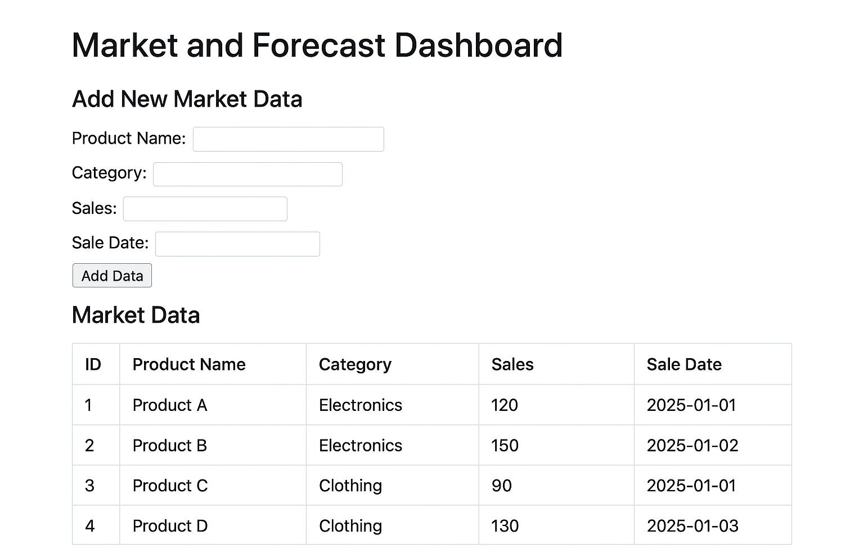
Output

Slide 18
Challenges & Solutions
During my internship.I faced a few technical and professional challenges while working on the Market and Forecast web application. On the technical side, understanding how market forecasting works and learning to use HTML, PHP, and SQL together was a bit difficult in the beginning. Designing the database, creating tables, and writing correct SQL queries to get the required data needed extra care. Connecting the frontend (HTML) with the backend (PHP) and database (SQL) also caused some errors, which required a lot of debugging and testing to fix.
To solve these issues, I took help from my mentor whenever I had doubts and used online tutorials to practice HTML, PHP, and SQL coding. I created a small Flowchart to plan how data should be stored and connected. Each part of the project was tested separately before joining everything together, which reduced errors and made the system work smoothly.
Apart from technical issues, I also faced time management and professional challenges. Completing all tasks within one month while learning new things was not easy. I also had to adjust to working in a professional setup—keeping proper documentation, following coding rules, and using Git for saving and managing my work. To handle this, I divided the project into small weekly tasks, maintained regular communication with my mentor, and participated in reviews to improve my coding and project management skills.

Slide 19
Conclusion & Future Scope
Conclusion: During my internship, I gained real practical experience in web development by working on the Market and Forecast web application. This project helped me connect what I learned in theory with real-life application. I worked on different stages such as requirement analysis, frontend design using HTML, backend development using PHP, and database handling using SQL. I learned how to solve technical problems through debugging and testing, which improved my problem-solving skills. With the constant guidance and feedback from my mentor, I also improved in documentation, coding practices, and professionalism. Along with technical learning, I developed important soft skills like teamwork, time management, and communication. Overall, this internship gave me confidence and prepared me well for future work in the field of web development.
Future Scope: The Market and Forecast application can be improved further to make it more powerful and user-friendly. New features like interactive dashboards, better data visualization, and machine learning algorithms can make the forecasts more accurate. Adding a cloud-based database would allow users to access the system from anywhere. The application can also be made mobile-friendly and more secure with user login features. Using modern web frameworks can enhance the design, speed, and overall performance of the system. With continuous improvements, this project has strong potential to become a complete and practical tool for real-world market analysis and forecasting.

Slide 20
